Slide 1

The Caffeine Experience
Done by:
Jasper Guay, Donovan Tan,
Tan Mei Xuan, Mabel Lim & Nurasilah
Notes:
Need to decide when to show the dashboard.

Slide 2

Agenda
Objective
Food and Beverage Analysis
Methodology
Food insights
Beverage insights
TCE items analysis
Competitor Analysis
Methodology
Insights
Conclusion

Slide 3
1.
Objective

Slide 4

Business Questions
What food items can TCE add to the menu or improve on?
What can we learn from the top competitors?

Slide 5
2.
Methodology
What was our thought process?

Slide 6
Research Process
How did we choose which food items to priorities on?

Slide 7
Shortlisting Process
Categorise into ‘Food’ and ‘Beverage’
2 Metrics used:
Average Polarity
Total Count (Reviews)
Take the top 3 from each metrics
12 food items to analyze (6 food & 6 drinks)
Notes:
**Talk about why you removed some items: become 9 …
We don’t have descriptive reviews to come out with insights

Slide 8
Limitation
The content of the reviews were not always descriptive
E.g.: “The buttermilk waffle is the best I have ever tasted !!!”
Some of the top selected items did not have relevant insights
Filter down items with wide range of reviews

Slide 9
Insights/Features
Descriptive Analyzing:
“The buttermilk waffle was one of the better ones I had - crisp, but still soft and fluffy inside. Portion is quite substantial, but perhaps still better to share with friends.” - Reviewer of The Populus Coffee & Food Co.
Notes:
After looking at the statistics, we moved on to looking at the reviews itself

Slide 10
3.
Insights

Slide 11

Suggested Food Items

Slide 12
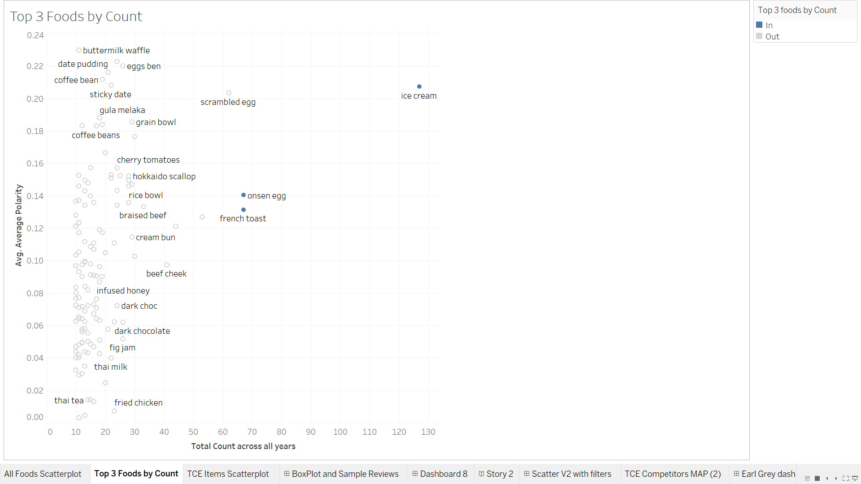
Top Food Items By Count
Ice Cream
Onsen Egg
French Toast

Slide 13
Top Food Items by Count: Ice Cream
Ice cream well prefered with lots of toppings
“...Thankfully there were passionfruit curd, raspberry puree, honeycomb, chocolate crumbs and hazelnut crumbs to add some fruitiness, sweetness, light buttery and savory tastes to it. Great way to end our meal! 😉” - Reviewer of The Populus Coffee & Food Co.

Slide 14
Top Food Items by Count: Ice Cream
A lot of toppings
Vanilla flavour to balance out
Do not add two strong flavours together
Overwhelming
Ruins the taste of the other flavour

Slide 15
Top Food Items by Count: Onsen Egg
Onsen egg is a must in rice bowl dishes
“... One of the essentials in my daily diet- the soft, fragile and runny yolk was a pleasant feast for the sight and sense, providing some moisture and flavours to the white rice as well! Portion is satisfying and filling for one, though I must admit the price is pretty steep for a rice bowl…”
- Reviewer of Lunar Coffee Brewers

Slide 16
Top Food Items by Count: Onsen Egg
Crisp and fluffiness
Runny, soft, fragile yolk
Often in rice bowl dishes
Provides moisture and enhances flavour

Slide 17
Top Food Items by Count: French Toast
French Toast should be fluffy
Served well with toppings
“Indulgence is having a really fat French toast served with a scooper full of raspberries and mascarpone cheese. I loved how fluffy the French toast in and how well it went with the citrusy flavours, but the portion was a little too much of an overkill.” - Reviewer of The Lokal

Slide 18
Top Food Items by Count: French Toast
Prefered to be fluffy and moist
Toppings: berries, cheese or fig jam
Avoid:
Portion too big
Sauce caused toast to be soggy
Charred sides

Slide 19
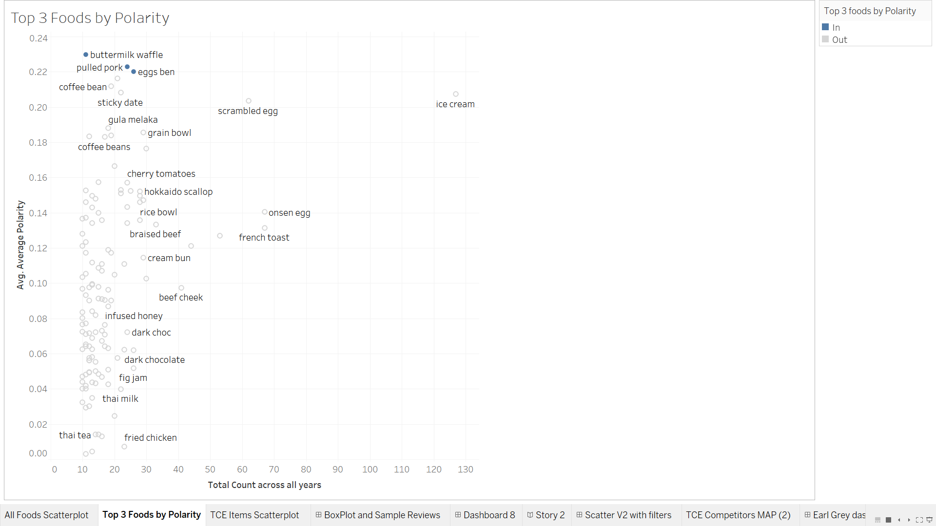
Top Food Items By Polarity
Buttermilk Waffle
Pulled Pork
Eggs Ben

Slide 20
Top Food Items by Polarity: Buttermilk Waffle
Must be crisp and fluffy, soft inside.
“The buttermilk waffle was one of the better ones I had - crisp, but still soft and fluffy inside. Portion is quite substantial, but perhaps still better to share with friends.” - Reviewer of The Populus Coffee & Food Co.

Slide 21
Top Food Items by Polarity: Buttermilk Waffle
Crisp and fluffiness
Avoid:
Not crisp enough
Soggy due to ice cream
Too thick

Slide 22
Top Food Items by Polarity: Pulled Pork
Tenderness and flavour
Taste and how well it is roasted
Avoid:
Dry and not tender

Slide 23
Top Food Items by Polarity: Eggs Ben
Large portion
Combo well with unagi, mentaiko sauce and smoked salmon
Crunchy toast
Avoid:
Pricey
Make the eggs ben worth the price

Slide 24
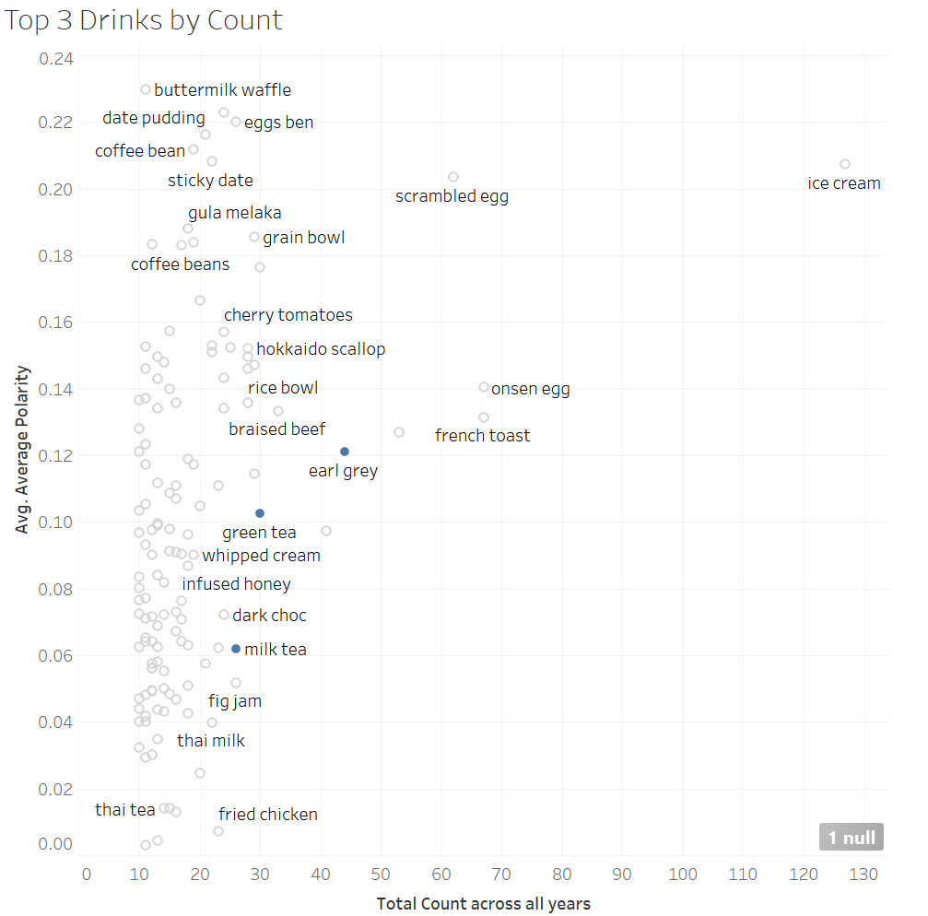

Slide 25
Top Beverage by Count: Earl Grey
Yuan Yang Earl Grey by Dapper coffee

Slide 26
Top Beverage by Count: Earl Grey
Yuan Yang Earl Grey by Dapper coffee
Harmonious
Lavender petals added for extra fragrance
Refreshing

Slide 27
Top Beverage by Count: Earl Grey
Other Insights
A flavour for desserts:
Ice cream, cake, e.t.c.
Makes for an interesting flavor

Slide 28
Top Beverage by Count: Green Tea
A popular variant: Milk tea
Balance milk and tea
Avoid:
Too much milk
Making it overly sweet

Slide 29
Recommendation for Green Tea
Ensure balanced flavour in beverages - a good ratio of milk, tea and syrup
Famous as a flavour profile - TCE can introduce food items such as green tea cakes and ice cream

Slide 30
Top Beverage by Count: Milk Tea
Perfect Balance
Not too sweet
Quality ingredients
Healthier choice
Avoid:
Can be tasteless at times

Slide 31
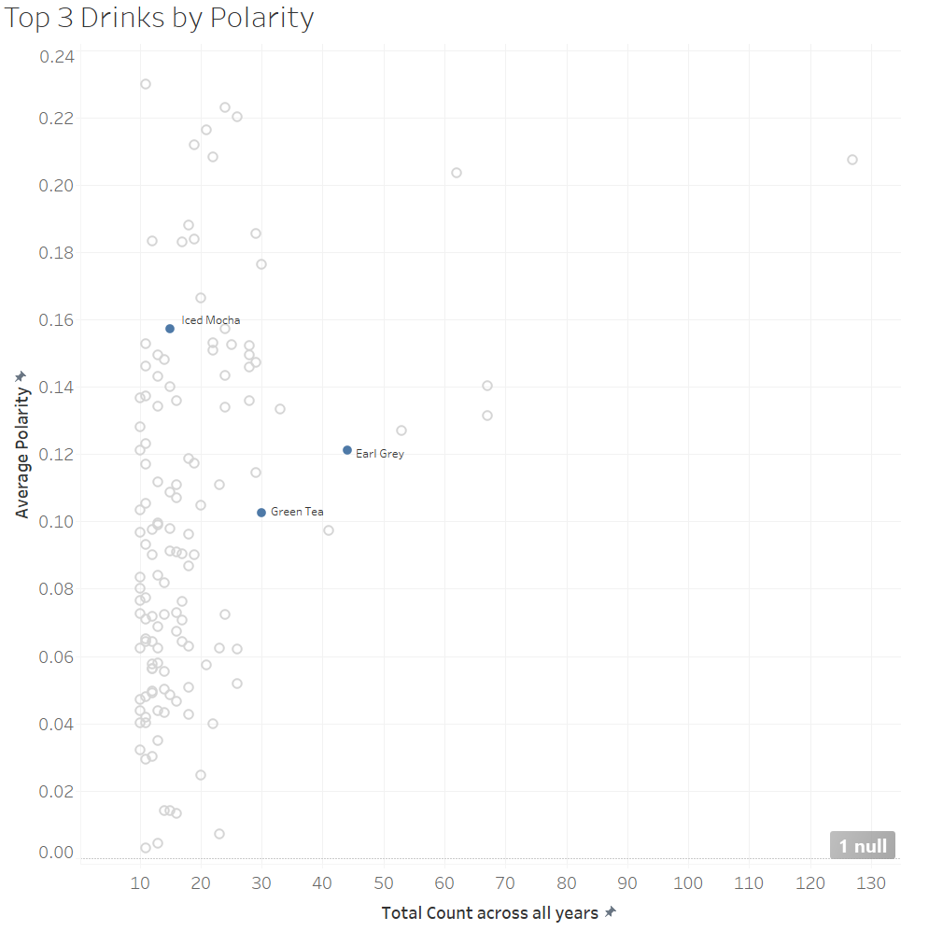
Notes:
Must mention that due to the limitation of the data, we can select no more than 3 items, so we cannot replace the thai tea and coffee.

Slide 32
Top Beverage by Polarity: Iced Mocha
Strong and rich flavour of chocolate
Smooth texture
Addition of syrup
Avoid:
Adding too much milk
Dilutes the flavour of the chocolate

Slide 33
Recommendation for Iced Mocha
Offer a rich chocolate mocha
Serve milk on the side - lets consumer tweak to their preferences
Variety of flavour syrups to tweak flavours

Slide 34
Competitor Analysis

Slide 35
Insight 2: Competitor Analysis
Competitor Analysis Methodology
Competitors Map Visualisation
Competitor Insights

Slide 36
Competitor Analysis Methodology

Slide 37
Competitor Analysis Methodology
How should we look at the cafe industry?
Who are my competitors?
Why are my competitors doing so well and what can i learn from them?

Slide 38
Competitor Analysis Methodology
Approached the analysis in a statistical manner
Only considered competitors in Tanjong Pagar
Metrics used: No. of reviews & Polarity
Prioritized cafes with higher No. of reviews over higher polarity

Slide 39
Competitor Analysis Methodology

Slide 40
Competitor Analysis Methodology
How should we look at the cafe industry?
Who are my competitors?
Why are my competitors doing so well and what can i learn from them?

Slide 41
Competitor Analysis Methodology
Approached the analysis in a statistical manner
Only considered competitors in Tanjong Pagar
Metrics used: No. of reviews & Polarity
Prioritized cafes with higher No. of reviews over higher polarity

Slide 42
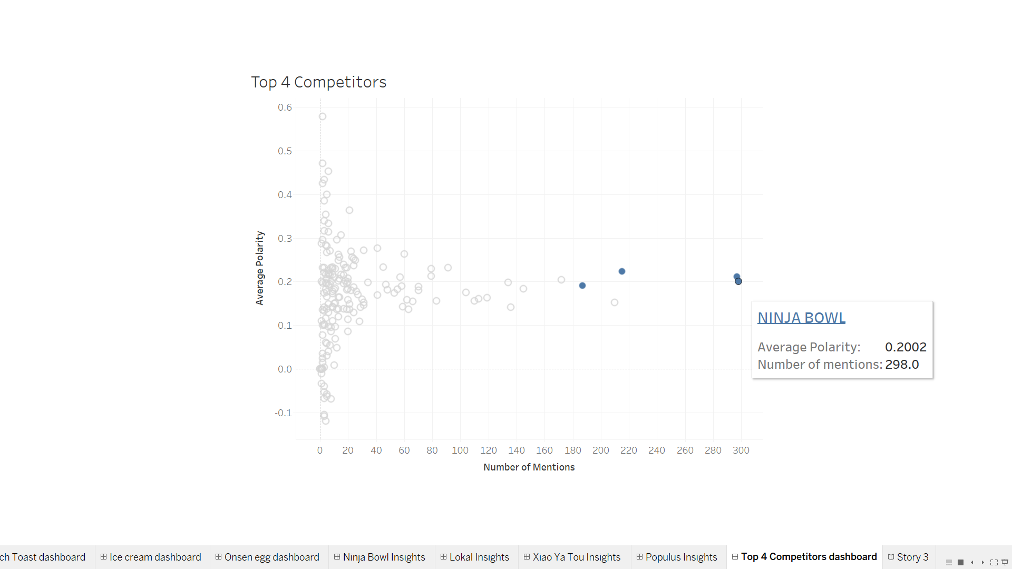

Slide 43
Competitor Map Visualisation

Slide 44
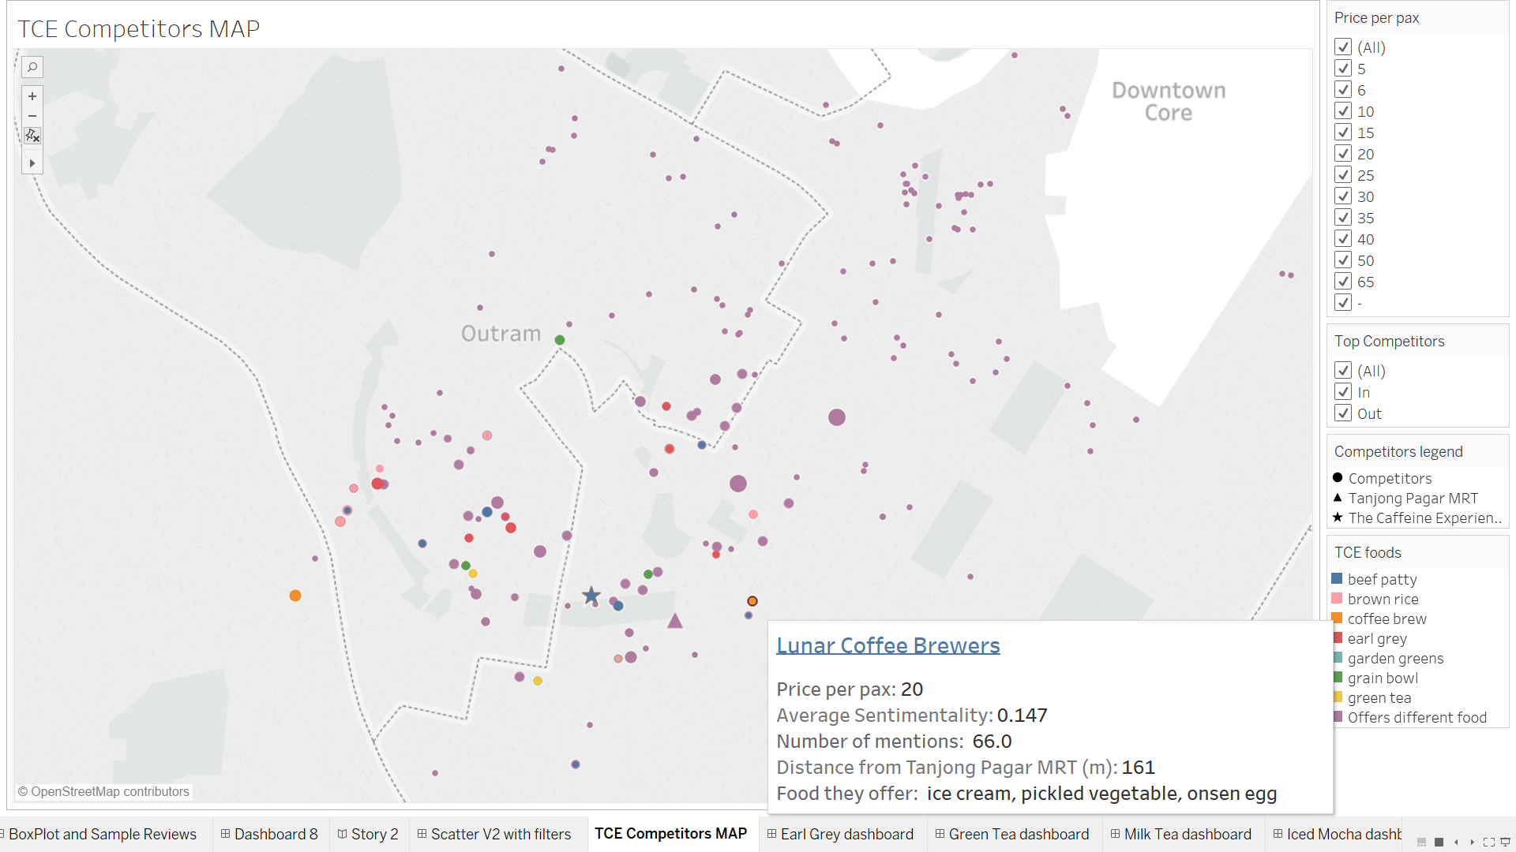

Slide 45
Competitors
Insights on our competitors

Slide 46
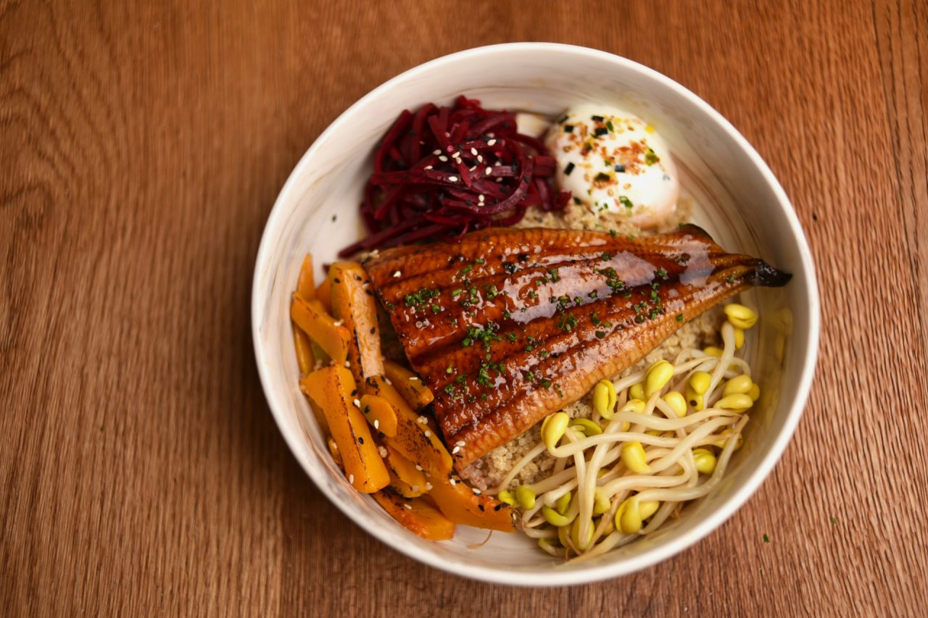
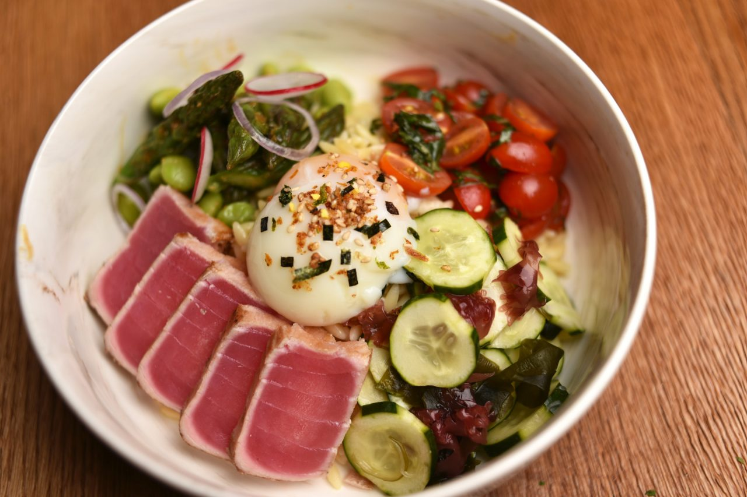
Ninja Bowl
Offers a variety of greens that appeals to healthy eaters
Avocado, asparagus,cherry tomatoes are frequently mentioned
Notes:
https://www.ninjabowl.com.sg/wp-content/uploads/2016/04/Tsukiji-Bowl-1280x853.jpg
https://www.ninjabowl.com.sg/wp-content/uploads/2016/04/Genki-Bowl-1280x853.jpg

Slide 47
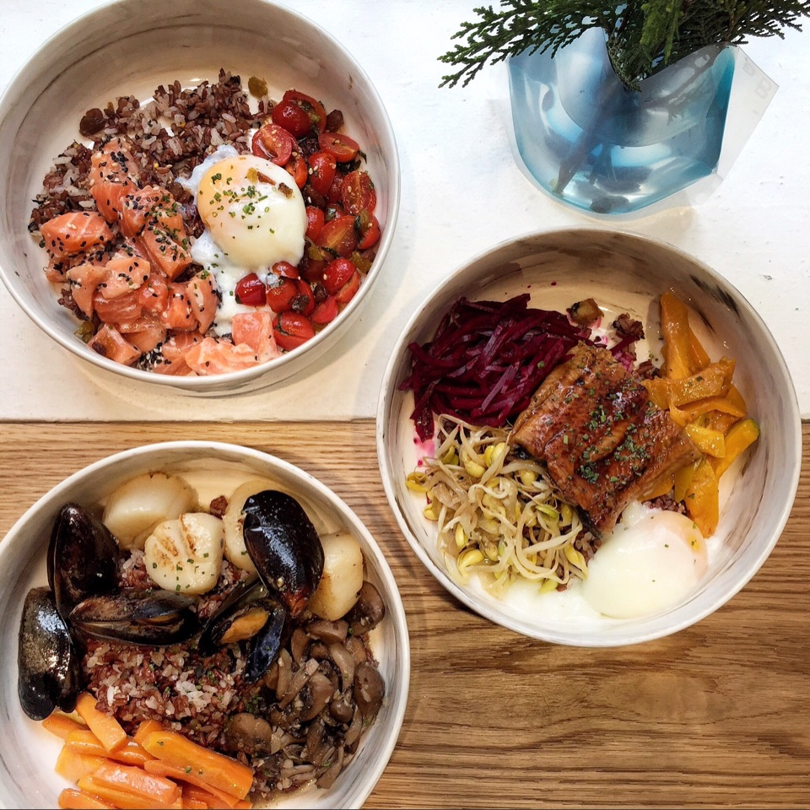
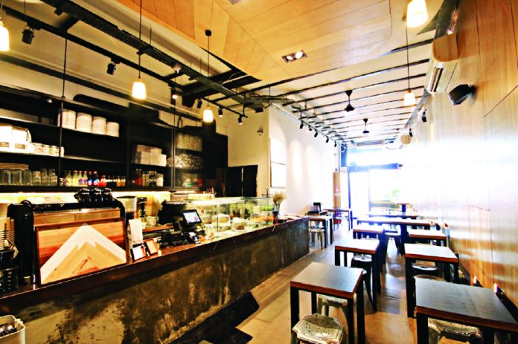
Ninja Bowl
Interiors are beautiful and lightings are great
Food setting and marble bowls are praised
Very Instagrammable
Notes:
http://wattention.com.sg/wp-content/uploads/2016/05/interior-696x463.jpg
http://sphm-finder-site-production.s3-ap-southeast-1.amazonaws.com/2018/03/ninja-bowl.jpg
https://s3.burpple.com/foods/52a21d58aef7fbc66a1392202_original.?1460456117

Slide 48
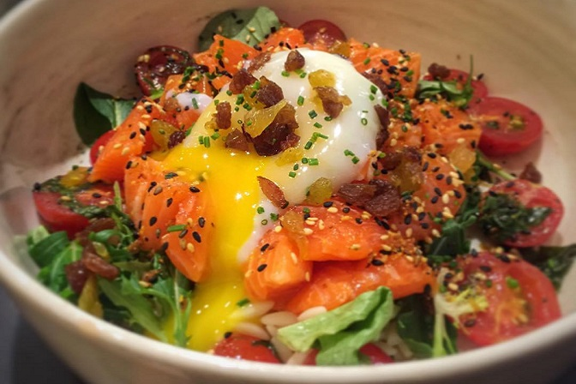
Ninja Bowl
Generous with their servings
Did not skimp on premium ingredients
Reviewers were willing to pay

Slide 49
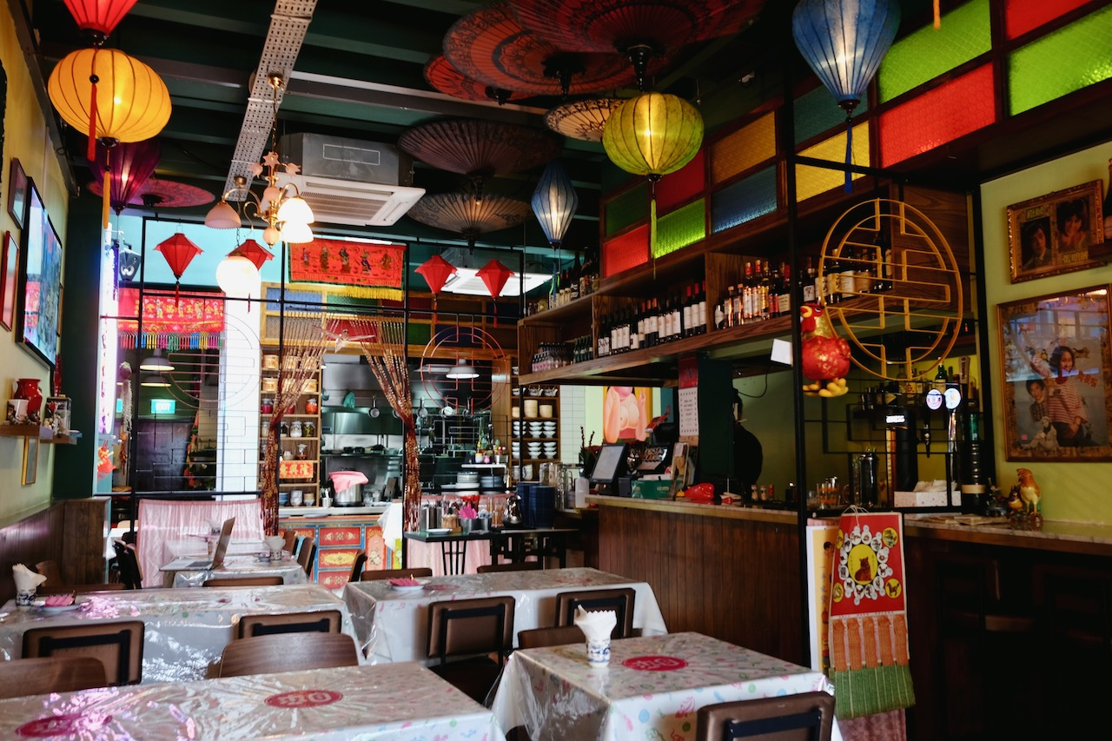
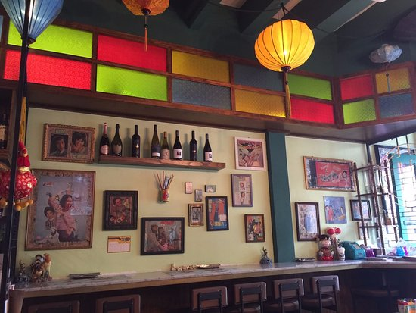
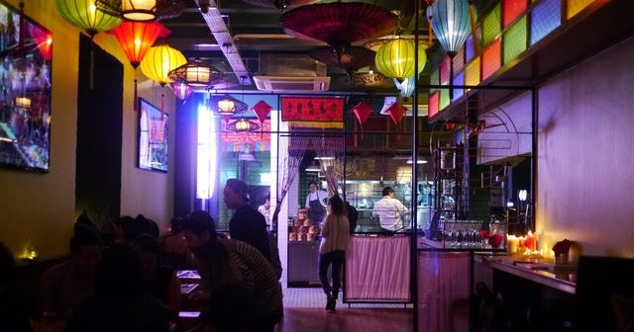
Xiao Ya Tou
Widely praised for oriental interiors
Proved to be a memorable point for reviewers
Notes:
http://css.ricemedia.co/wp-content/uploads/2017/02/Rice-Media-Double-Boiled-Xiao-Ya-Tou-Identity-Crisis-1.jpg
https://fa707ec5abab9620c91c-e087a9513984a31bae18dd7ef8b1f502.ssl.cf1.rackcdn.com/11578235_new-restaurant-xiao-ya-tou-at-6-duxton_7ded02c2_m.jpg?bg=523A47
https://media-cdn.tripadvisor.com/media/photo-s/0e/b7/ac/da/interior-of-xiao-ya-tou.jpg

Slide 50
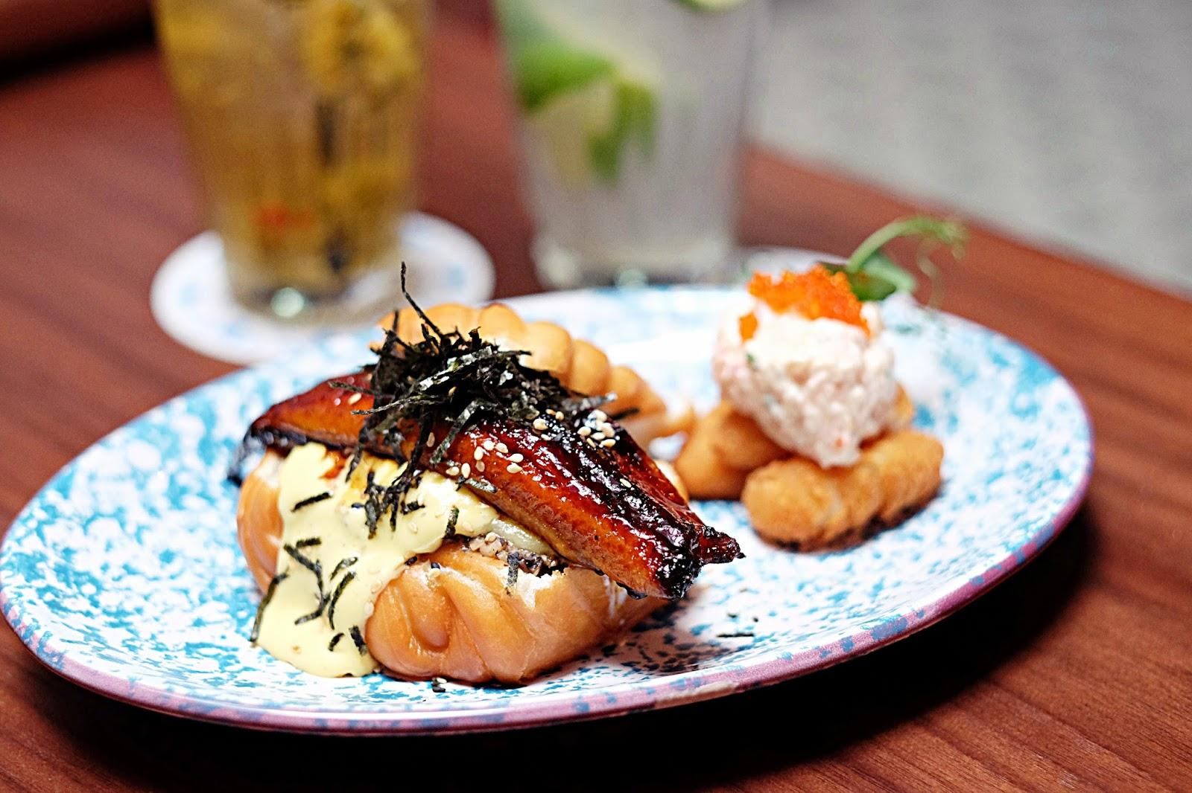
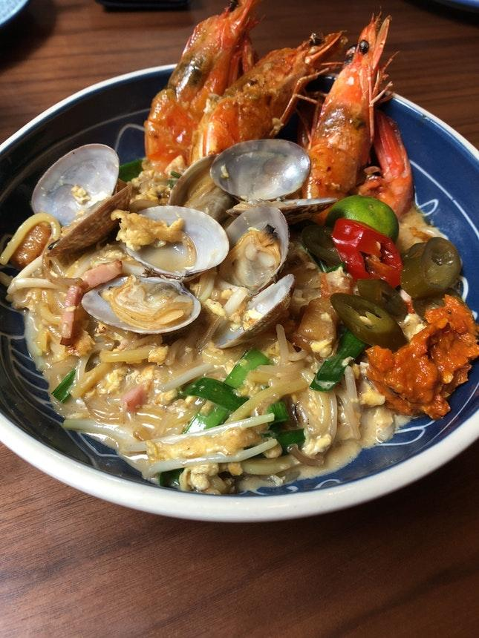
Xiao Ya Tou
Extensive mentions about fusion
Exotic dishes brings out new and exciting flavours
Notes:
https://3.bp.blogspot.com/-OJmJVl_CAk0/WZiYPA5DVHI/AAAAAAAAObU/1GEwuJwNTKEV2omm46x4rOuKdJJNKV4iACLcBGAs/s1600/batch_DSCF5017.JPG
https://burpple-1.imgix.net/foods/c5b1ba64f9ea3bbb6e1628432_original.?w=645&dpr=1&fit=crop&q=80

Slide 51
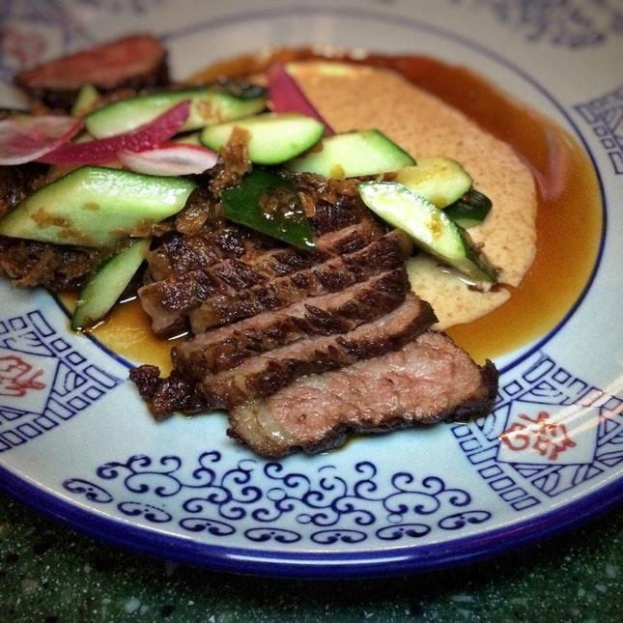
Xiao Ya Tou
Preparation of food was taken into consideration by reviewers
Plenty of mentions on the over 30 hour sous vide prepared short ribs
Notes:
https://burpple-1.imgix.net/foods/17f3bc8819258d6f01502735_original.?w=645&dpr=1&fit=crop&q=80

Slide 52
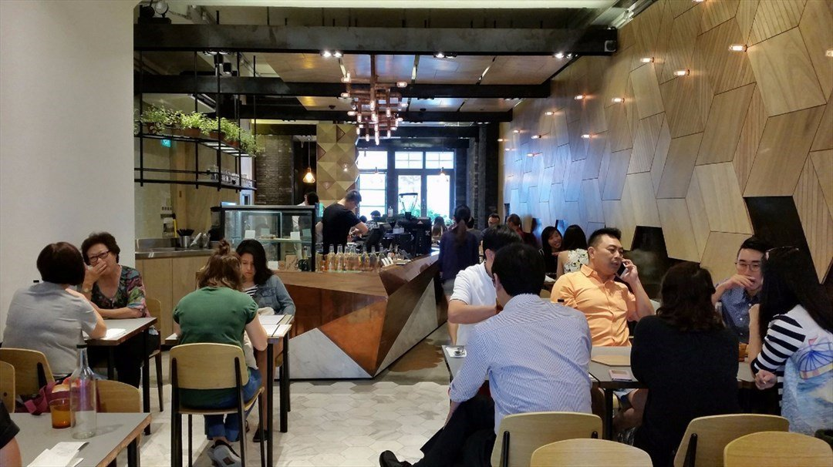
The Populus Coffee & Food Co.
Modernistic and Classy design
Widely praised for their interior aesthetics

Slide 53
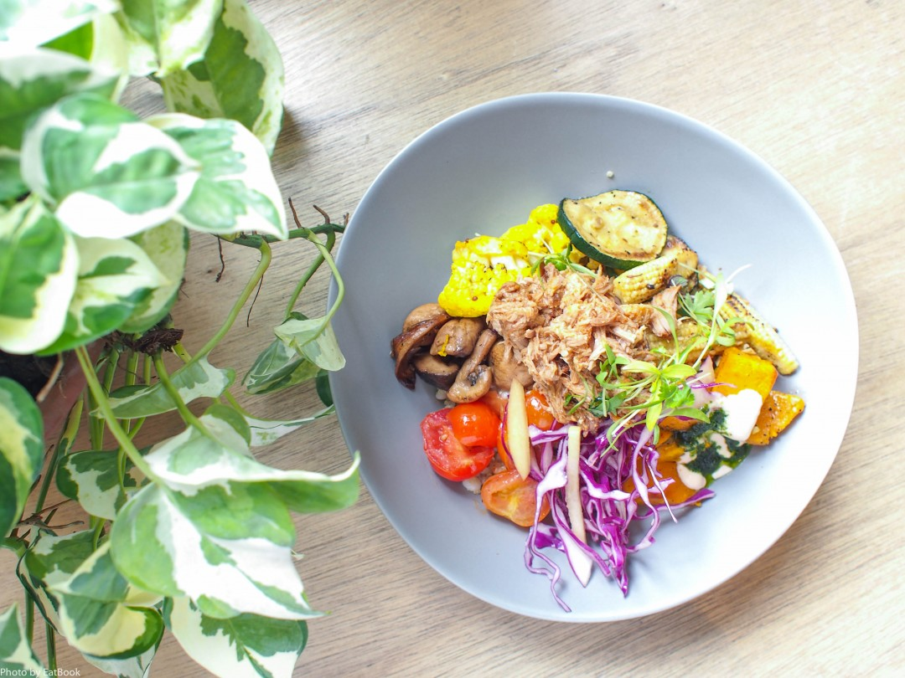
The Populus Coffee & Food Co.
Vibrantly coloured
Used vastly different coloured foods
Aesthetic appeal was a factor in their minds

Slide 54
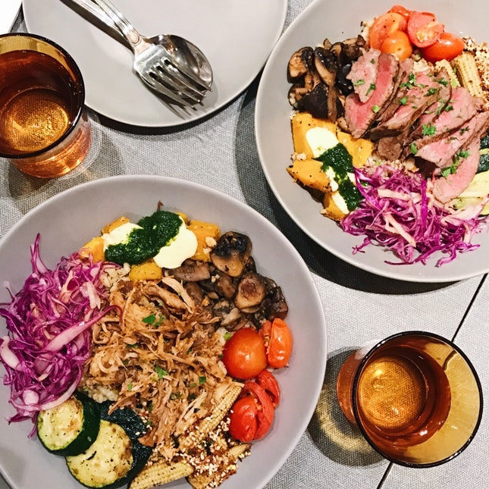
The Populus Coffee & Food Co.
Refreshing effect
Incorporated light ingredients
Great balance of flavours

Slide 55
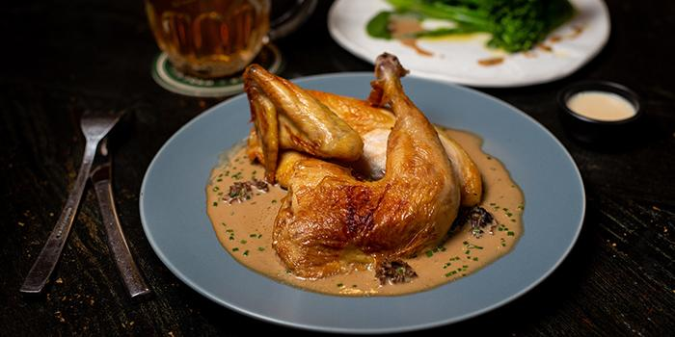
The Lokal
Generous Portions
Worth the price
House-made ingredients were used over pre-prepared ingredients
Notes:
https://d2jzxcrnybzkkt.cloudfront.net/uploads/2018/07/Lokal_Roasted_Half_Kampong_Chi_1532687826.jpg?date=201807231900

Slide 56
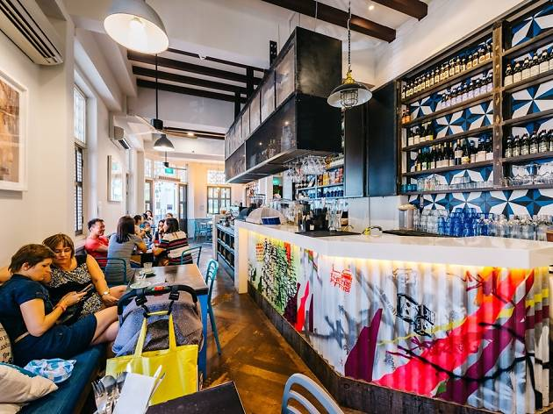
The Lokal
Great Ambience and Atmosphere
Homy vibe and great service
Wasn’t too noisy or intrusive

Slide 57
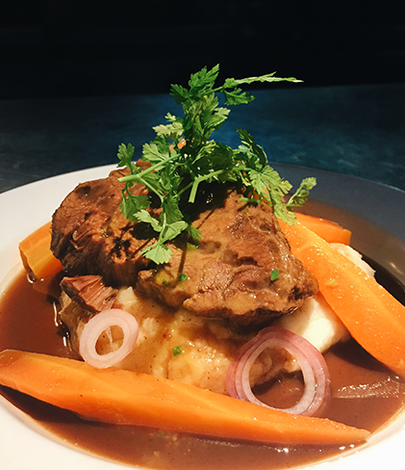
The Lokal
Flavourful dishes
Meats were soaked in sauce
Reviewers enjoyed savoury sauces with a zesty/spicy kick to make the dish more appetizing

Slide 58
Conclusion

Slide 59
Conclusion: Suggested Items
Ice cream
Onsen Egg
French Toast
Buttermilk Waffle
Pulled Pork
Eggs Ben

Slide 60
Conclusion: Competitor Analysis
Ice cream
Onsen Egg
French Toast
Buttermilk Waffle
Pulled Pork
Eggs Ben

Slide 61
Thanks!
Any questions?

Slide 62
Spice up the slides fam
https://docs.google.com/presentation/d/1E6PQdZgbrTXPVefUXl-IqGYZDHf0tnDm_BUAwablwIU/edit?usp=sharing

